Slide 1

Les minutes MLOps
L’annotation
Guillaume Chervet

Slide 2


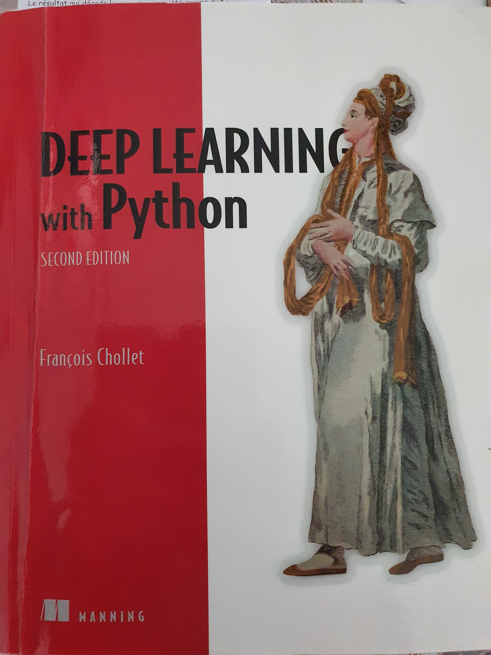
Deep Learning
1) Paradigm shift : Skills
Machine Learning
Data
Rules
Answers
Source : François Chollet
Les minutes MLOps – Guillaume Chervet - 2023
Notes:
Changement de paradigme : compétences, projets, etc.

Slide 3

Deep Learning
2) Paradigm shift : Data
Les minutes MLOps – Guillaume Chervet - 2023
Notes:
In the past, we used to talk about project as “model centric”, because we weren't sure we could make an appropriate AI.
Today most of the points on the AI ​​side: at least for our needs at AXA France, already have viable solutions. We know that we will be able to create an AI for our use cases.
On the other hand, the heart of the problem, really the thing that makes a project feasible or not: it is the data. If we have good data, of good quality, inputs and answers, a lot, that will really be game changer to the success of your project. The data is your treasure that will make the difference.

Slide 4

Les minutes MLOps – Guillaume Chervet - 2023

Slide 5
Les minutes MLOps – Guillaume Chervet - 2023

Slide 6
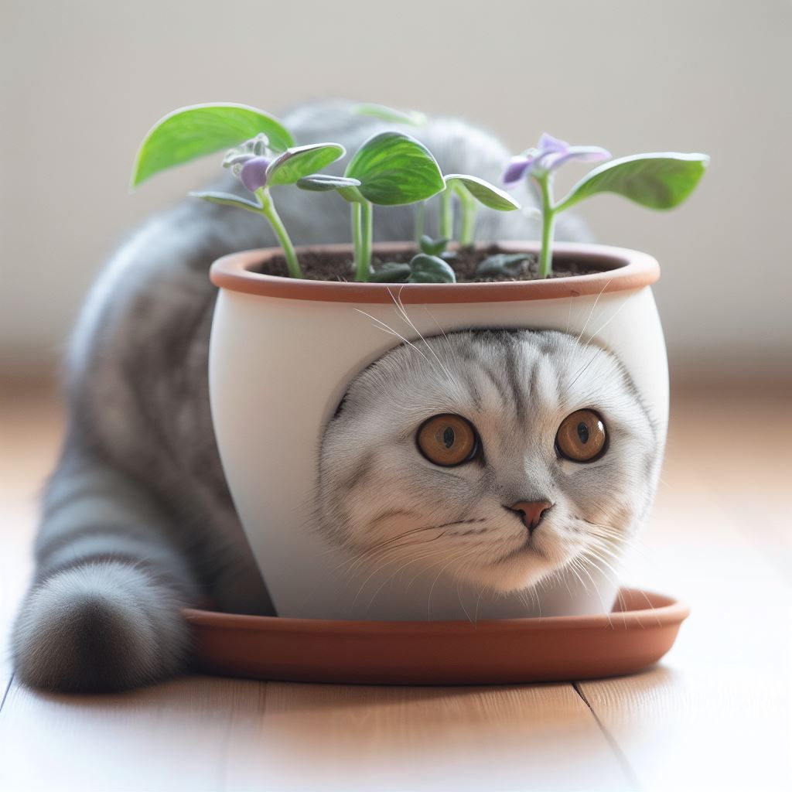
Les minutes MLOps – Guillaume Chervet - 2023

Slide 7
Les minutes MLOps – Guillaume Chervet - 2023

Slide 8
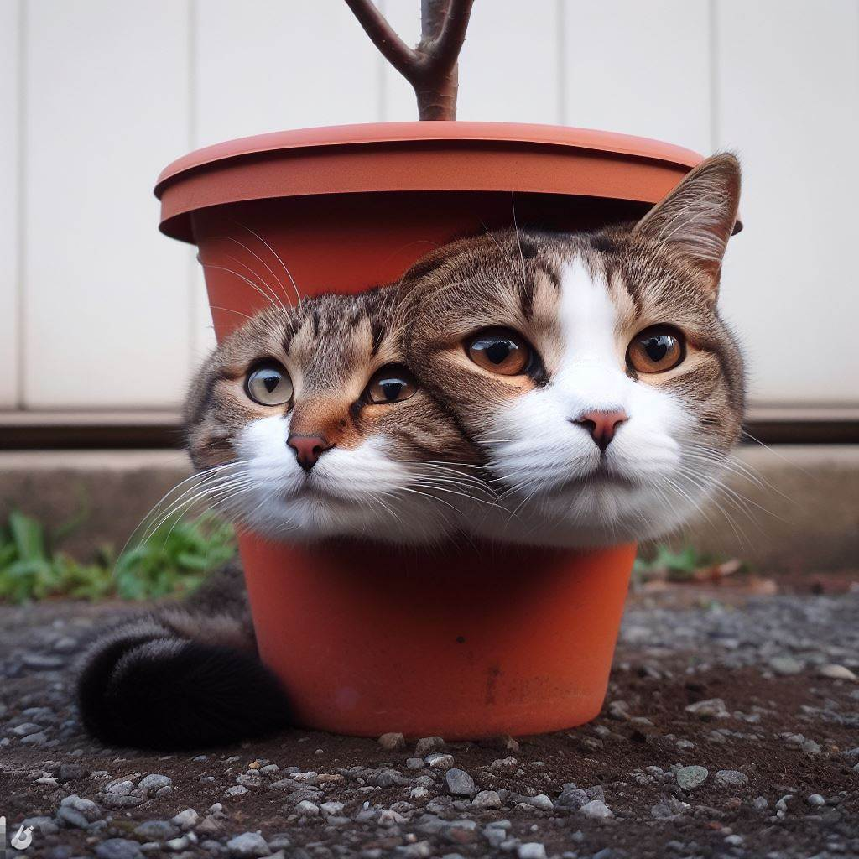
Les minutes MLOps – Guillaume Chervet - 2023

Slide 9
Les minutes MLOps – Guillaume Chervet - 2023

Slide 10
Les minutes MLOps – Guillaume Chervet - 2023

Slide 11
Les minutes MLOps – Guillaume Chervet - 2023

Slide 12
Les minutes MLOps – Guillaume Chervet - 2023

Slide 13
Les minutes MLOps – Guillaume Chervet - 2023

Slide 14
Les minutes MLOps – Guillaume Chervet - 2023

Slide 15
Les Minutes MLOps heu c’est top !
Les minutes MLOps – Guillaume Chervet - 2023

Slide 16
Les Minutes MLOps heu c’est top ! Les Minutes MLOps … c’est top !
Les minutes MLOps – Guillaume Chervet - 2023

Slide 17
Les Minutes MLOps heu c’est top ! Les Minutes MLOps … c’est top ! Les minutes MLOps c’est top !
Les minutes MLOps – Guillaume Chervet - 2023

Slide 18
Les Minutes MLOps heu c’est top ! Les Minutes MLOps … c’est top ! Les minutes MLOps c’est top ! Les Minutes MLOps, c’est top !
Les minutes MLOps – Guillaume Chervet - 2023

Slide 19
Les Minutes MLOps heu c’est top ! Les Minutes MLOps … c’est top ! Les minutes MLOps c’est top ! Les Minutes MLOps, c’est top ! Les minutes MLOps, c’est top.
Les minutes MLOps – Guillaume Chervet - 2023

Slide 20
Experts
Les minutes MLOps – Guillaume Chervet - 2023

Slide 21
Cross annotation
Les minutes MLOps – Guillaume Chervet - 2023

Slide 22

Ecotag
Deep Learning
3) Paradigm shift : It’s alive
Les minutes MLOps – Guillaume Chervet - 2023
Notes:
Changement : c’est vivant, comme qqun qui apprend, il doit continuer à s’adapter. Et donc on doit relivrer fréquemment pour s’adapter aux nouvelles data.

Slide 23
Labelling
collect
Datasets
use
Train AI
deploy
Production AI API
use
Consumer Production application
collect
Feedback Loop
Les minutes MLOps – Guillaume Chervet - 2023
Notes:
In production, it is extremely important to set up what is called: the “feedback loop”. A virtuous circle. In the event of a classification error, the client applications must allow the error to be corrected manually. Over time, we will be able to build new dataset of a better quality and we will be able to improve our Artificial Intelligence.

Slide 24
Conclusion
Les minutes MLOps – Guillaume Chervet - 2023

